Slide 1

TE REO MŌ TE HUI

Slide 2
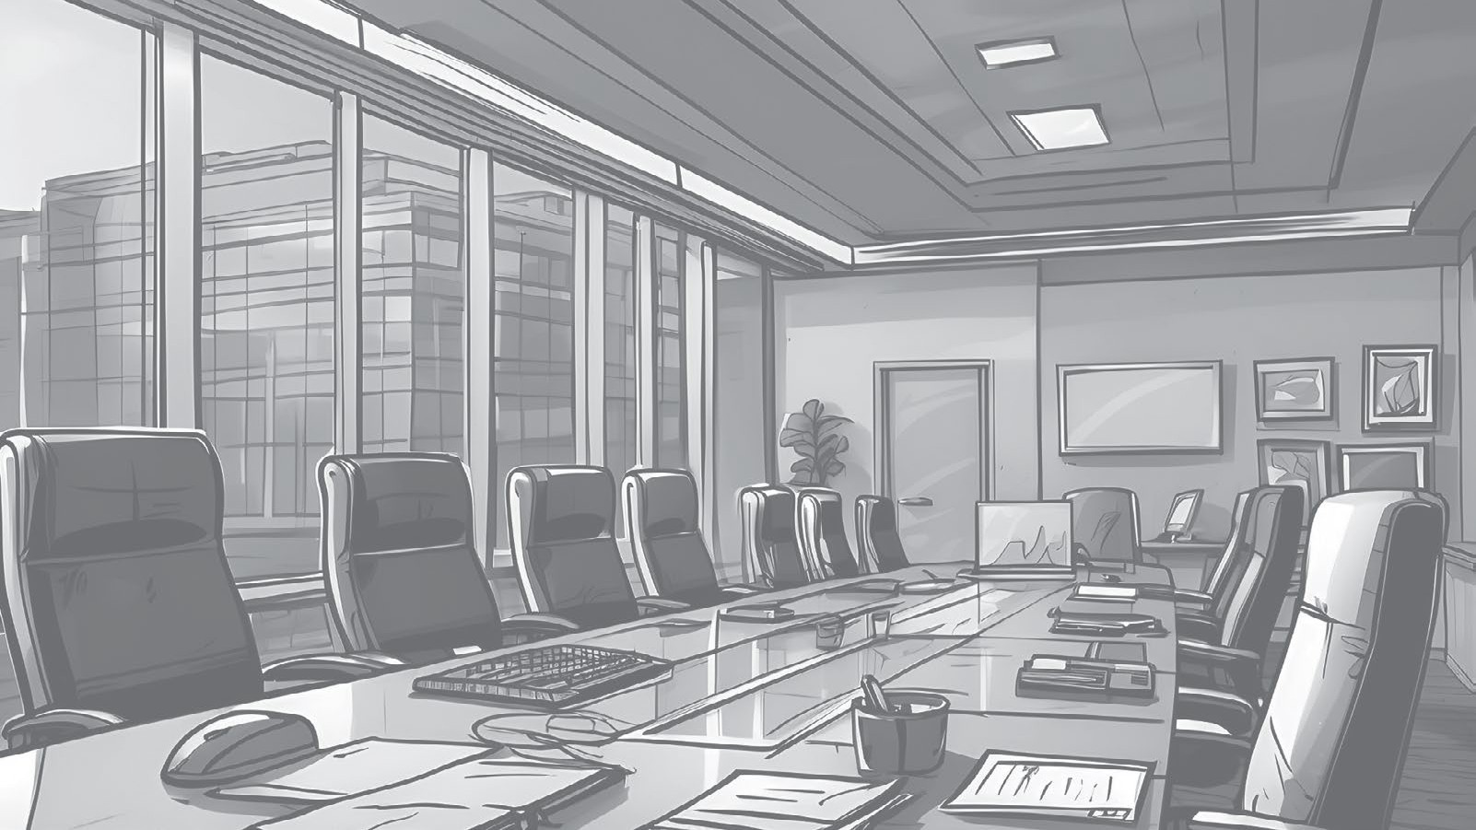
Te Ihirangi Contents
Karakia | 3 | He Whakamānawa | 13
He Arataki Guidance | 4 | Compliments He Tūtohu | 15
He Mihi Greetings | 6 | Recommendation He Tūmahi | 16
He Rārangi Take The Agenda | 7 | Actions He Whakarāpopoto | 17
Hauora Wellbeing | 8 | Summary He Whakakapi | 18
Ngā Kōrero Hou Updates | 9 | Closing He Whakatā | 19
He Whakamārama Clarification | 10 | Relaxing He Waiata | 20
He Whakaae | 11 | Karakia | 21
Agreeing He Akiaki | 12 | He Kupu | 22
Encouragement
Kitea ai tēnei puka me ngā oro taunaki ki konei
This book and supporting audio can be found here

Slide 3
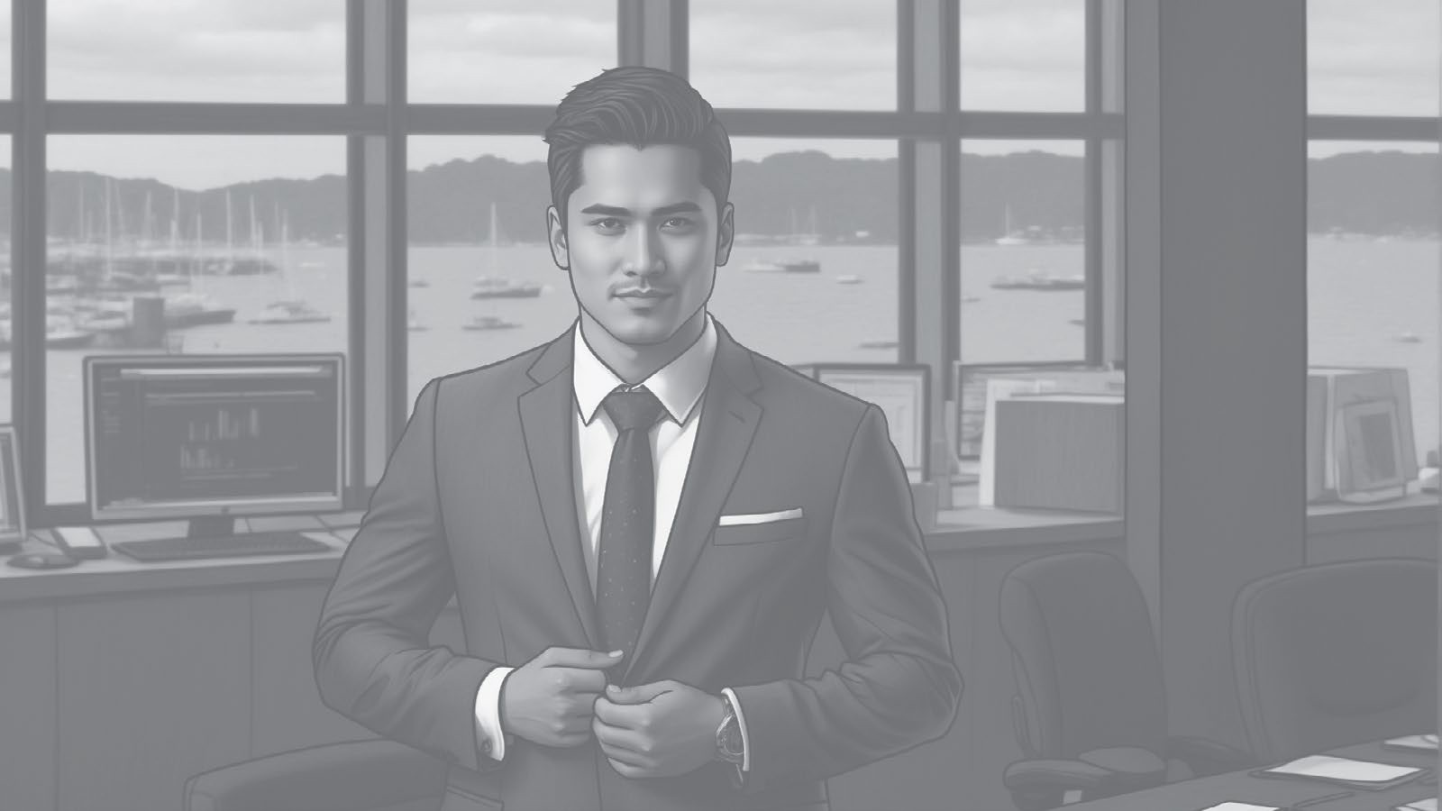

Karakia
Kia tau iho rā te mauri
Ki tēnei wāhi, ki tēnei hui Kia kotahi te ngākau
Kia kotahi te hinengaro Kia kotahi tātou i a tātou Hui e!
Tāiki e!
Ko tā te karakia he tō i te aro ki te mahi o te wā, arā, he hui, he hāereere, he tīmata i te rā, he kai rānei.
Karakia are a means to bring focus and set the intention for the activity to be undertaken whether that is a meeting, travel, starting the day, or dining.
Mā te karakia e nohopuku ai tātou, e tohu ai hoki whaitake tā tātou whakakotahi.
Karakia allow us to take a moment and signal that we are gathering with purpose.
Whakamahia ai ki te tō i a koe anō,
ā-tinana, ā-hinengaro, ā-kare ā-roto anō hoki.
They are used to engage yourself and others not just physically but mentally and emotionally.
Let’s be present
In this place, in this meeting One heart
One mind United Together! Make it so!

Slide 4
He Arataki Guidance
I ia rā hui ai tātou ki ngā whānau, ki ngā hoa, ki ngā hoa mahi, ā, ki ngā tāngata hou.
Every day, we meet with whānau, friends, colleagues or strangers.
Ko ngā hui katoa he ara e taea ai te whakauru, te whakamahi, me te whakamāori i te reo Māori.
Every meeting is an opportunity to introduce, practice, and normalise te reo Māori.
Kei tēnei puka ētahi kīanga e whakamahia nuitia ana i ngā hui.
This booklet provides phrases that are commonly used during meetings.
Whakawhitia ngā kīanga Pākehā ki te kīanga reo Māori i te hui o muri. Kia rite tonu tō pērā kia waia haere ai – arā, kia tau noa ai. Kātahi ka koke ki kīanga kē atu.
Replace one or two English phrases with a te reo phrase during your next meeting.
Stick to it, and it will become second nature – normalised. Then move on to another couple of phrases.
TE REO MŌ TE HUI

Slide 5
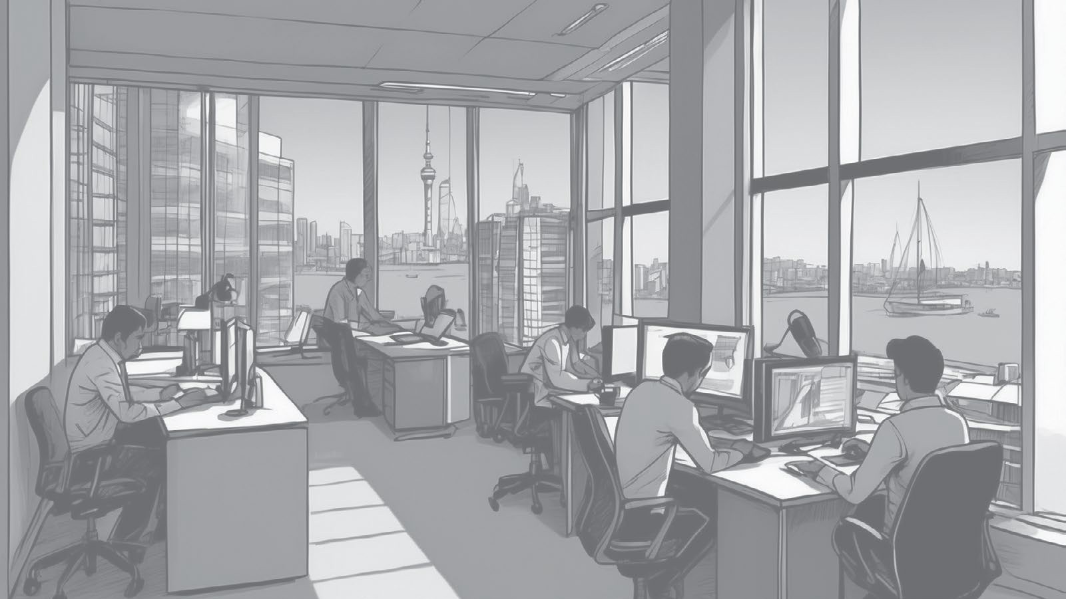



He Arataki Guidance
Māku ngā kīanga mā te hunga tauhou.
Māku ngā kīanga mā te hunga waenga.
Māku ngā kīanga mā te hunga tautōhito.
I’ll provide phrases for beginners.
I’ll provide phrases for intermediate learners.
I’ll provide phrases for advanced learners.
TE REO MŌ TE HUI

Slide 6
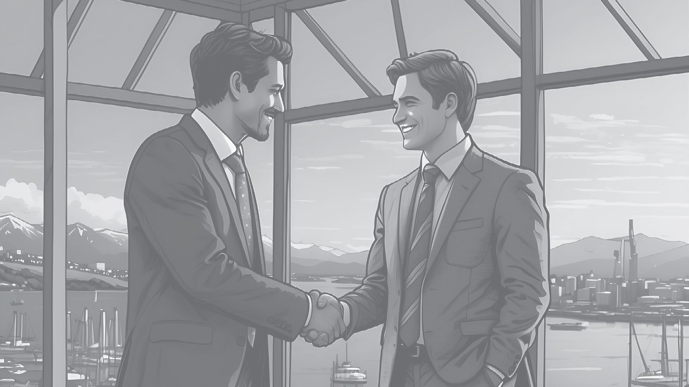
He Mihi Greetings
Mā te mihimihi e rangona ai ngā reo katoa o te hunga ka tae atu – kia kore ai tētahi e mahue.
Introductions allow us to hear the voices of all those who are present – ensuring no single contribution is left out.
Ākona he mihi poto i te ipurangi.
Learn a short mihi online.
He manuhiri/tangata tauhou kei waenga
i a tātou
Tēnā, whakamōhio mai ko wai tātou, he aha ā tātou mahi
Tēnā koutou katoa
Welcome all
We have guests/ new people
Let’s share who we are and what we do
TE REO MŌ TE HUI

Slide 7
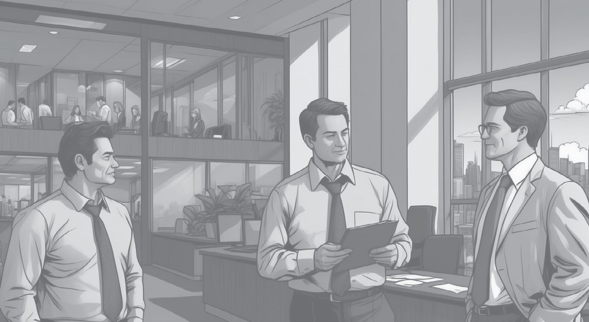
He Rārangi Take The Agenda
Ko te kaupapa tuatahi, ko...
He kaupapa anō?
Kia arotake tātou i te rārangi take
The first item is….
Anything else?
Let’s review the agenda
TE REO MŌ TE HUI

Slide 8
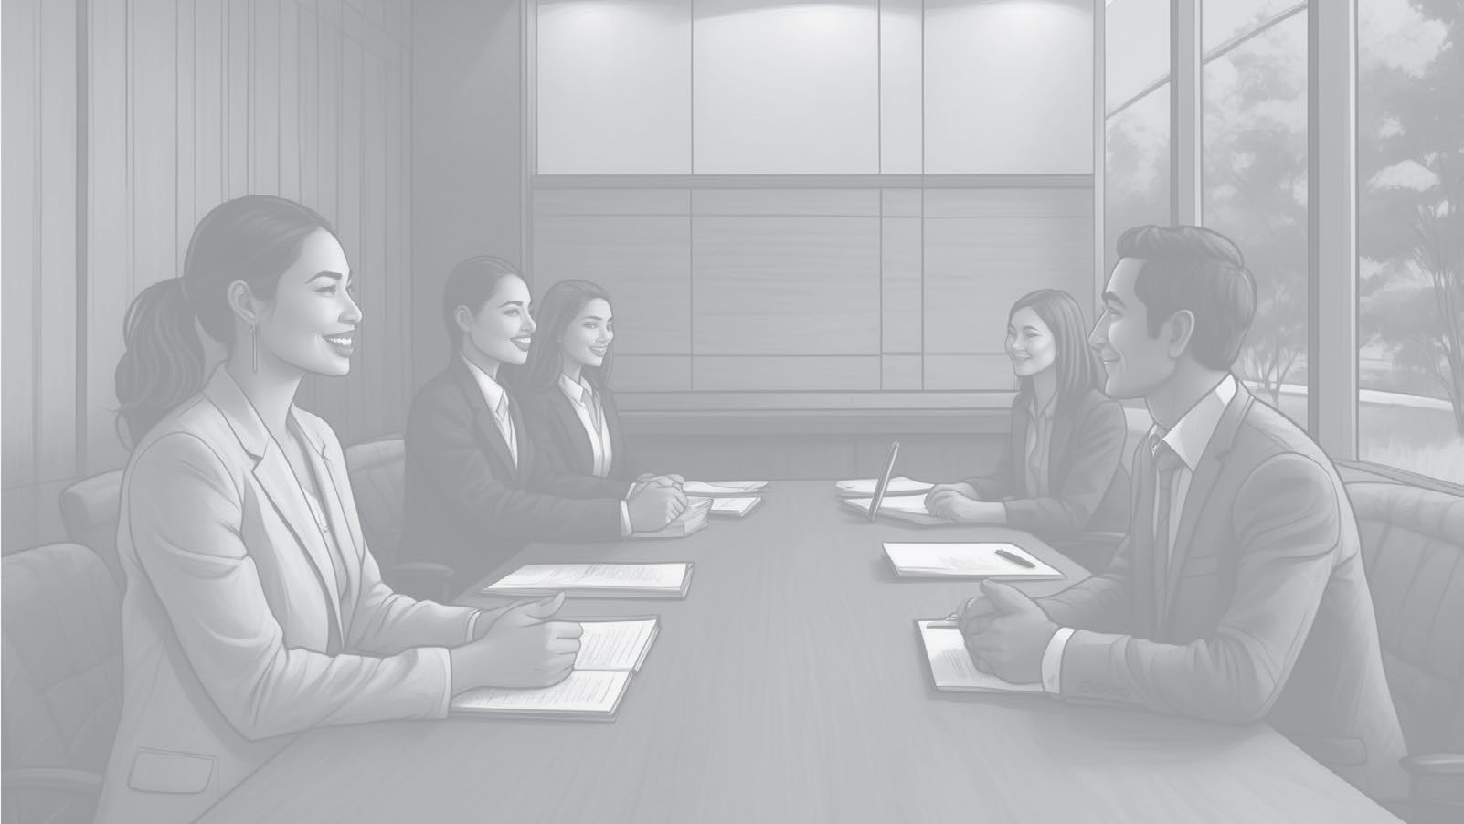








Hauora Wellbeing
Pōkaikaha
Stressed
Ngenge
Tired
Takeo
Frustrated
Hīkaka
Eager
Rangirua
Confused
Ohorere
Surprised
Pōuri
Down
Hiamo
Excited
Kei te pēhea koe?
I ahatia i tēnei mutunga wiki?
Ka taea e au te āwhina?
How are you feeling?
What happened this weekend?
Can I help?
TE REO MŌ TE HUI

Slide 9
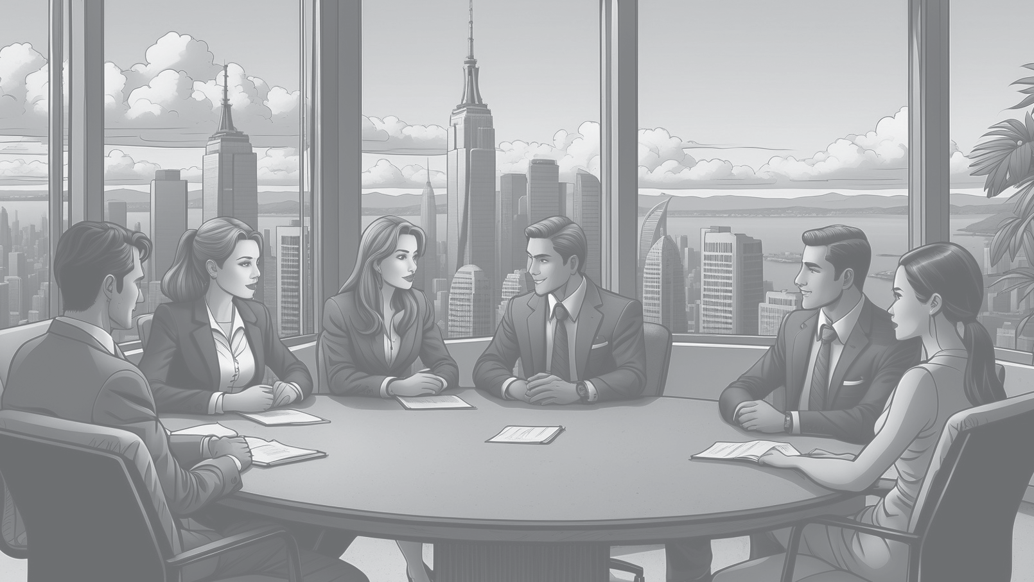
Ngā Kōrero Hou Updates
He aha ngā kōrero hou a te Tira Whakahaere/ ngā Minita?
E haere pai ana ngā mahi
He aha ka whai ake?
What’s the latest from SLT/Ministers?
Work’s tracking well
Next steps?
TE REO MŌ TE HUI

Slide 10
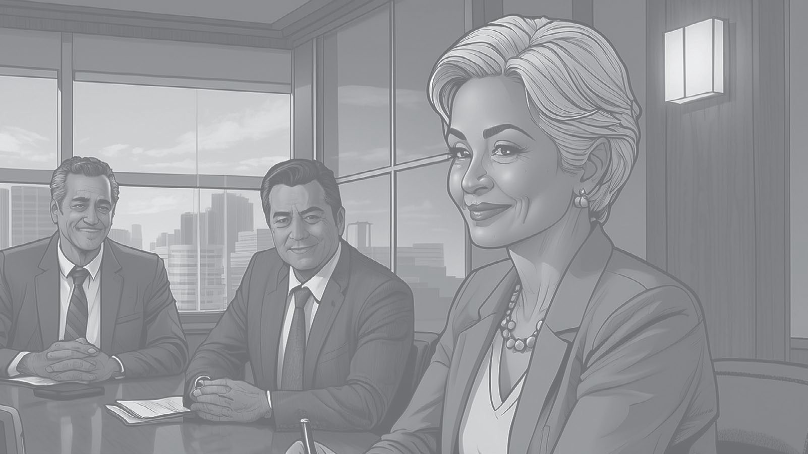
He Whakamārama Clarification
Nōku te hē
Kāore ahau i rongo i a koe
Tēnā, tōaitia mai
My bad
I didn’t hear you
Can you go over it again?
TE REO MŌ TE HUI

Slide 11
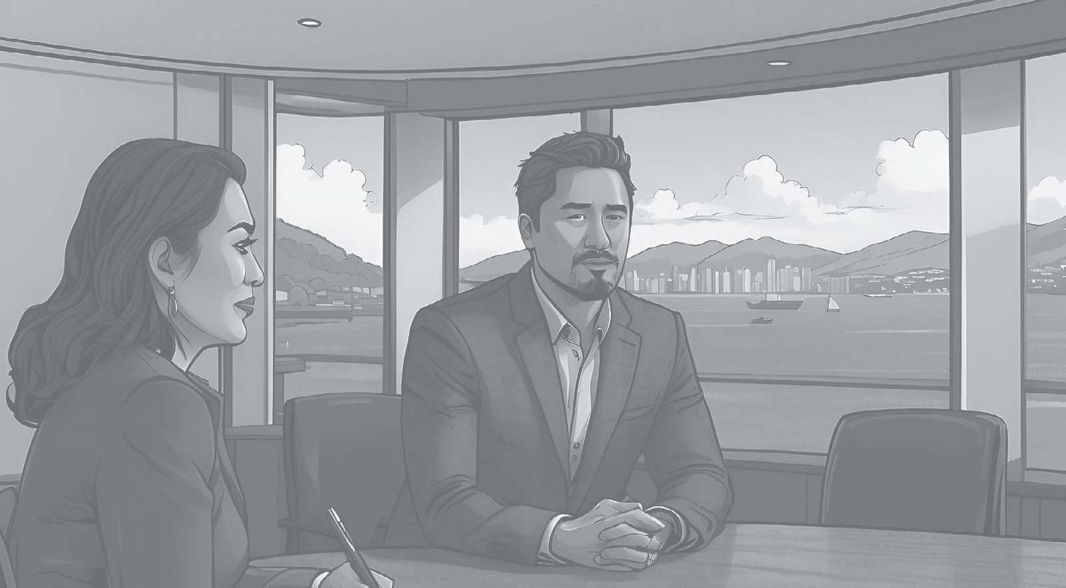
He Whakaae Agreeing
Kei konā au
Kāore au i te whakaae
Kimihia he whakatau
I agree
I disagree
Let’s find a compromise
TE REO MŌ TE HUI

Slide 12
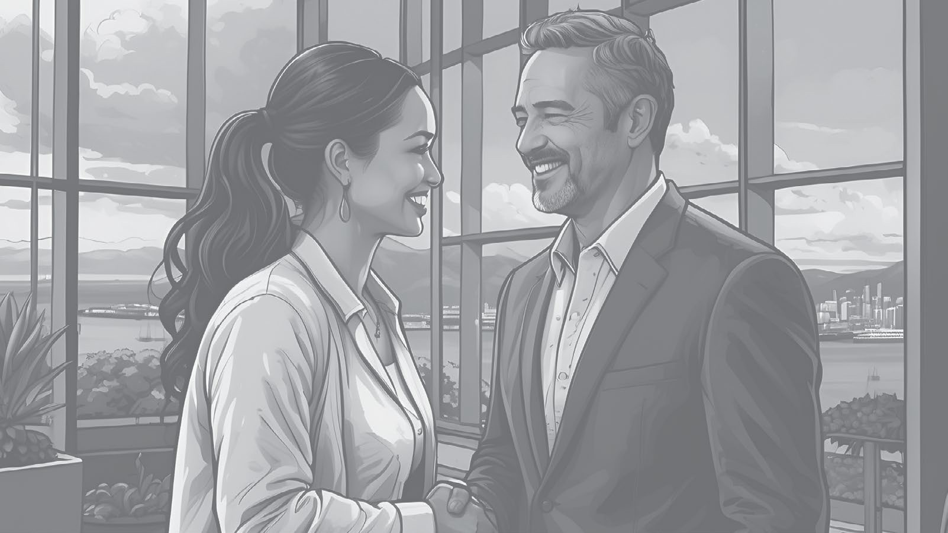
He Akiaki Encouragement
Kātahi te rā/wiki/ marama/tau roa ko tērā
Kātahi te rā/ wiki/marama/tau kūnakunaku ko tērā
He rōpū/hui uaua tērā
That was a tough crowd/ meeting
That was a long day/ week/month/year
That was a chaotic day/ week/month/year
TE REO MŌ TE HUI

Slide 13
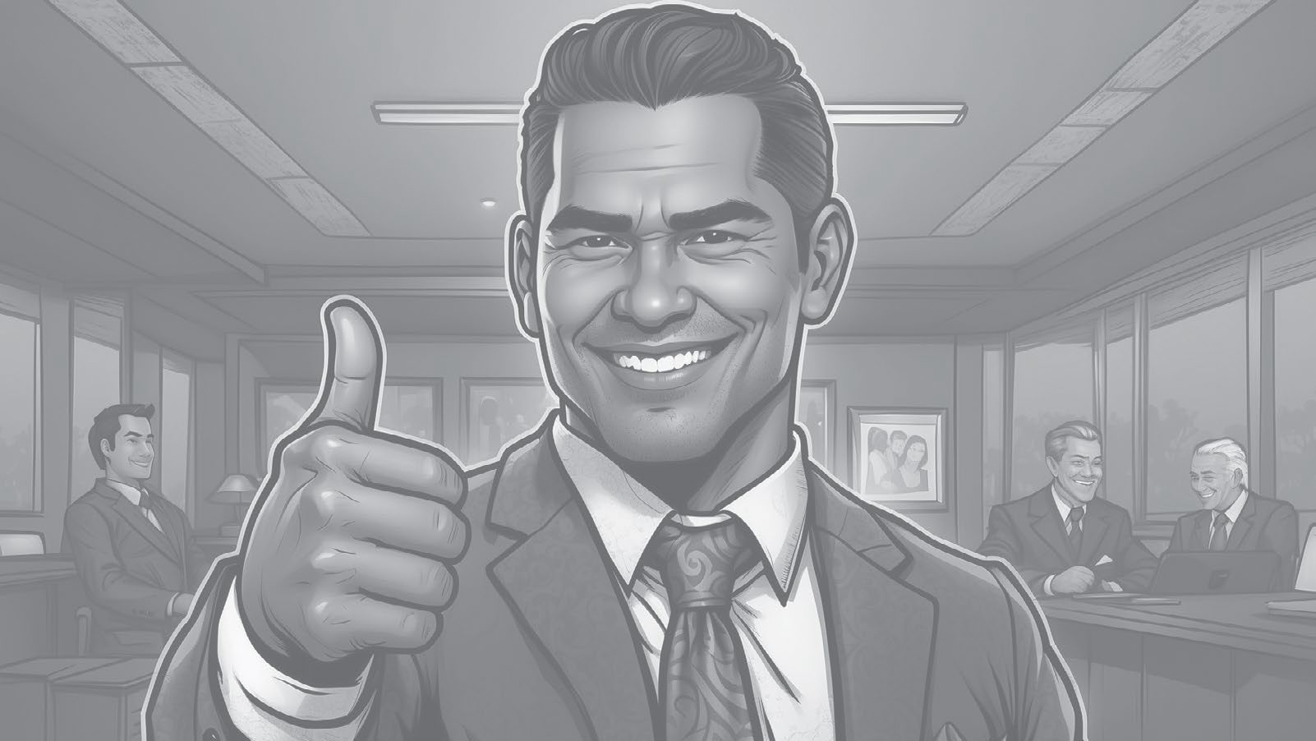
He Whakamānawa Compliments
Kātahi te wairua mākoha!
So kind!
Ko koe tētahi tangata tino tautoko!
You’re so supportive!
Mei kore koe...
I couldn’t have done it without you
Kei whea mai koe!
You’re the best!
Tō atawhai hoki!
You’re so generous!
Tēnā rā koe i ō mahi!
Thanks for everything you do!
Me nui ake taku kōrero pēnei
Whakamīharo ana
Kāore e rawea e te kōiraira!
I should say this more often
Wow. Just wow.
No flies on you!
TE REO MŌ TE HUI

Slide 14
He Whakamānawa Compliments
Mānawanawa
Patience
Atamai
Resourcefulness
Ngākau reka
Positive attitude
Manawanui
Dedication
Mauritau
Composure
Ngākau whiwhita
Passion
Ringa ngaio
Professionalism
Auahatanga
Creativity
Pūkenga whakaoti rapanga
Problem-solving skills
Pukumahi
Hard work
Mātanga
Expertise
Arotahi
Focus
Te pai mutunga o tō...
Haramai tō…
E wana ake ana i tō...
I’m impressed by your…
I appreciate your…
I am inspired by your…
TE REO MŌ TE HUI

Slide 15
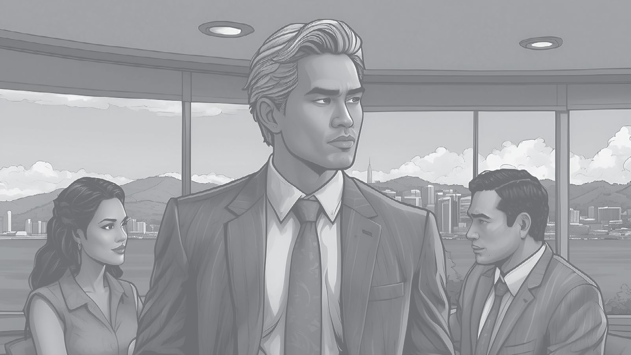
He Tūtohu Recommendation
Ka pai pea kia...
He whakaaro tōku
It might be good if...
I have an idea
Kia whakaarohia e tāua/tātou…
Let’s think about…
TE REO MŌ TE HUI

Slide 16
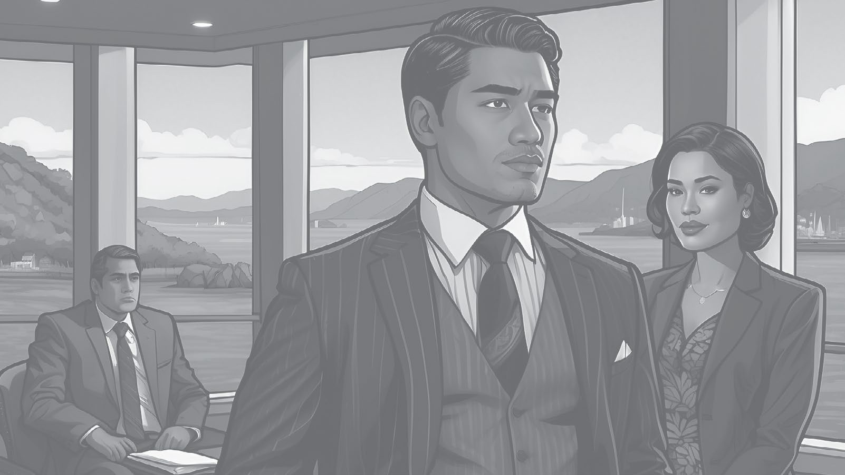
He Tūmahi Actions
Māku
I can do it
Ka taea e wai te hiki?
Who has capacity?
Ka tutuki tēnei i te Paraire?
Martha, ka kaha koe ki te āwhina i a Jim?
Kei te pokea ahau
I’m swamped
Can this be done by Friday?
Martha, can you help Jim?
TE REO MŌ TE HUI

Slide 17
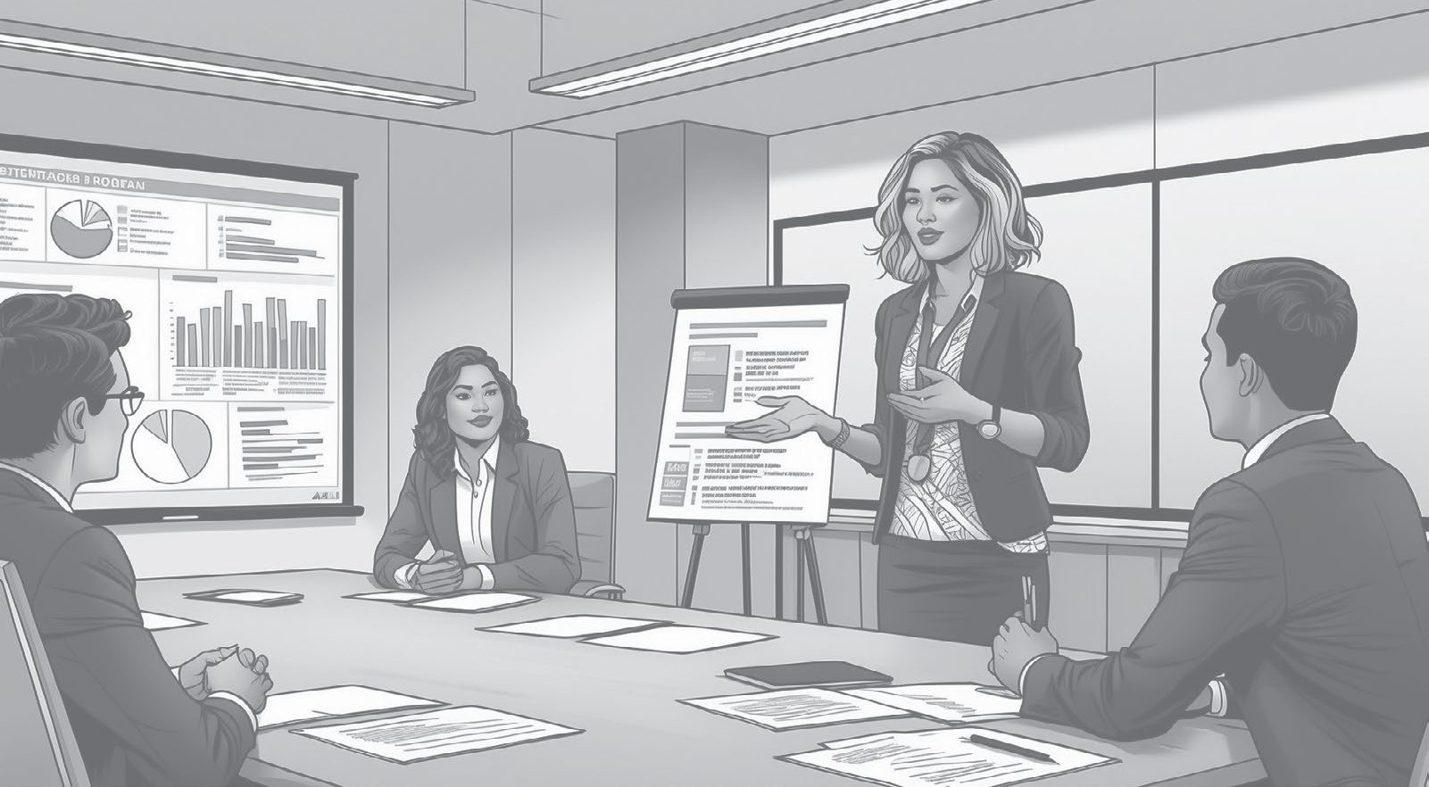
He Whakarāpopoto Summary
Hei whakakapi ake
Kua mahue tētahi kaupapa?
Kua matapakihia...
To wrap up…
Have we missed anything?
We’ve discussed…
TE REO MŌ TE HUI

Slide 18
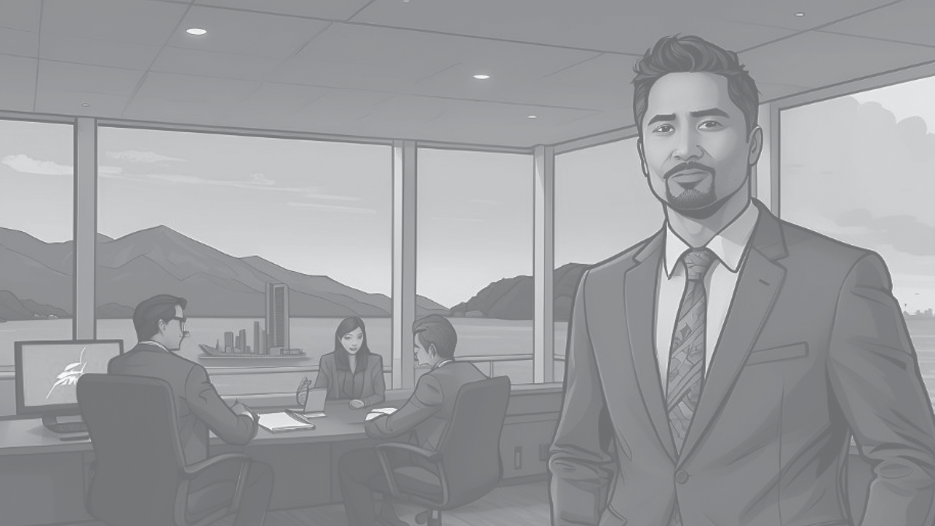
He Whakakapi Closing
Tēnā koutou i whai wāhi mai
Ka hui anō tātou ā te…
Thank you all for your contribution
Our next meeting will be on…
Ki te kore he whakaaro atu anō, kua kapi te hui
If there are no further thoughts, this concludes the meeting
TE REO MŌ TE HUI

Slide 19
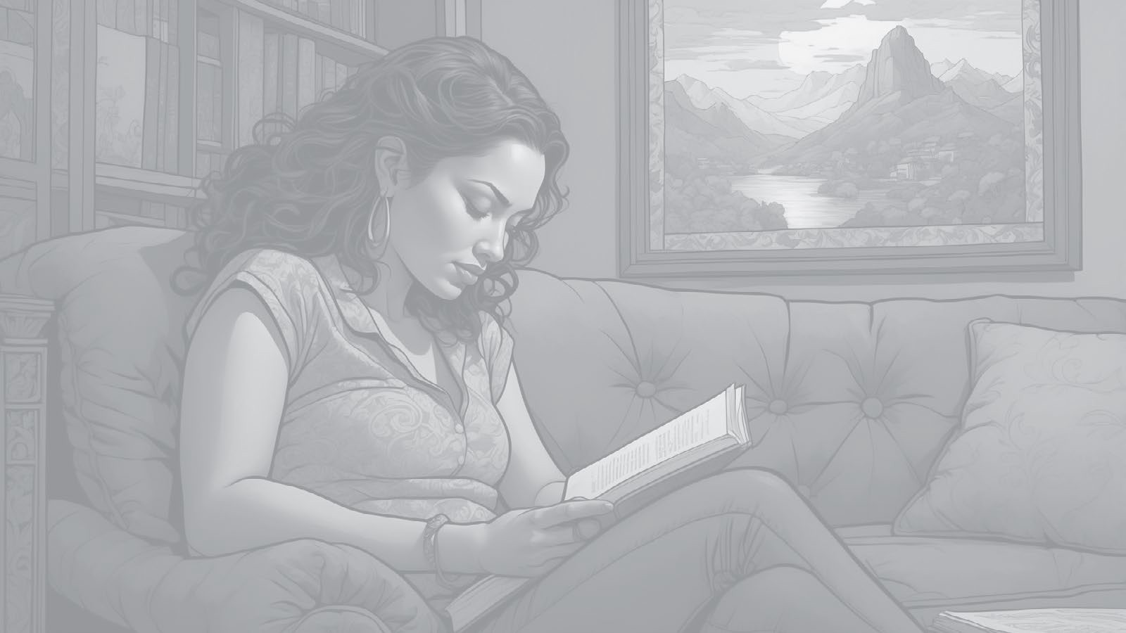
He Whakatā Relaxing
He aha tāu e hiahia nā?
E hiahia ana koe ki te kōrero, ki te noho puku rānei?
I pēhea te rā ki a koe?
Would you like to talk, or would you prefer some quiet time?
How was your day?
What do you need?
TE REO MŌ TE HUI

Slide 20
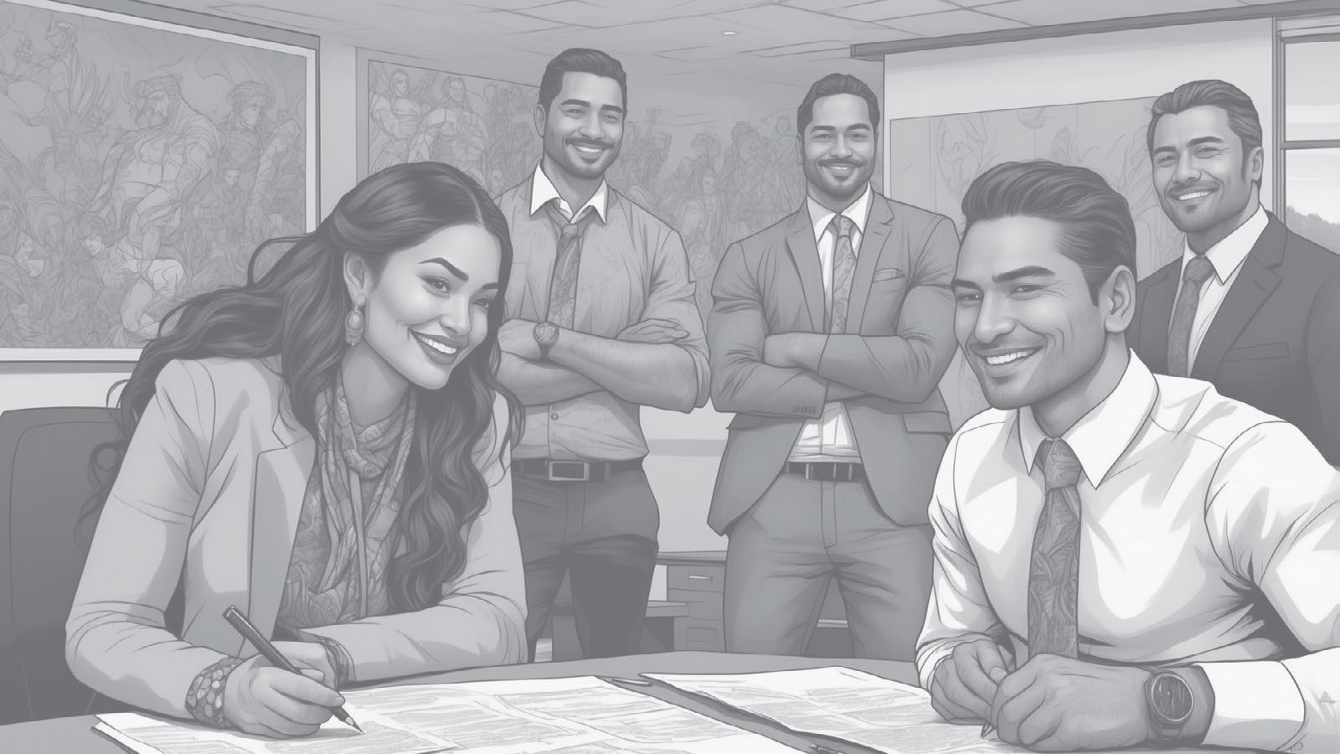
He Waiata
Poipoia te reo
Nā Te Tumatakuru O’Connell me Te Ama-Rere-Tai Rangihuna
Poipoia te reo
Composed by Te Tumatakuru O’Connell and Te Ama-Rere-Tai Rangihuna
Look after the language it’s precious Look after the language it’s valuable Encourage people
To take up the Māori language The Māori language
To be a precious heirloom for future generations Look after the language it’s precious
Look after the language it’s valuable Encourage people
To take up the Māori language The Māori language
To be a precious heirloom for New Zealand
Poipoia te reo he kura Poipoia te reo he kura Poipoia te tangata
Kia mau ko te reo Māori Ko te reo Māori
Hei taonga tuku iho mō ngā uri whakatupu e
Poipoia te reo he kura Poipoia te reo he kura Poipoia te tangata
Kia mau ko te reo Māori Ko te reo Māori
Hei taonga tuku iho mō Aotearoa e
TE REO MŌ TE HUI

Slide 21
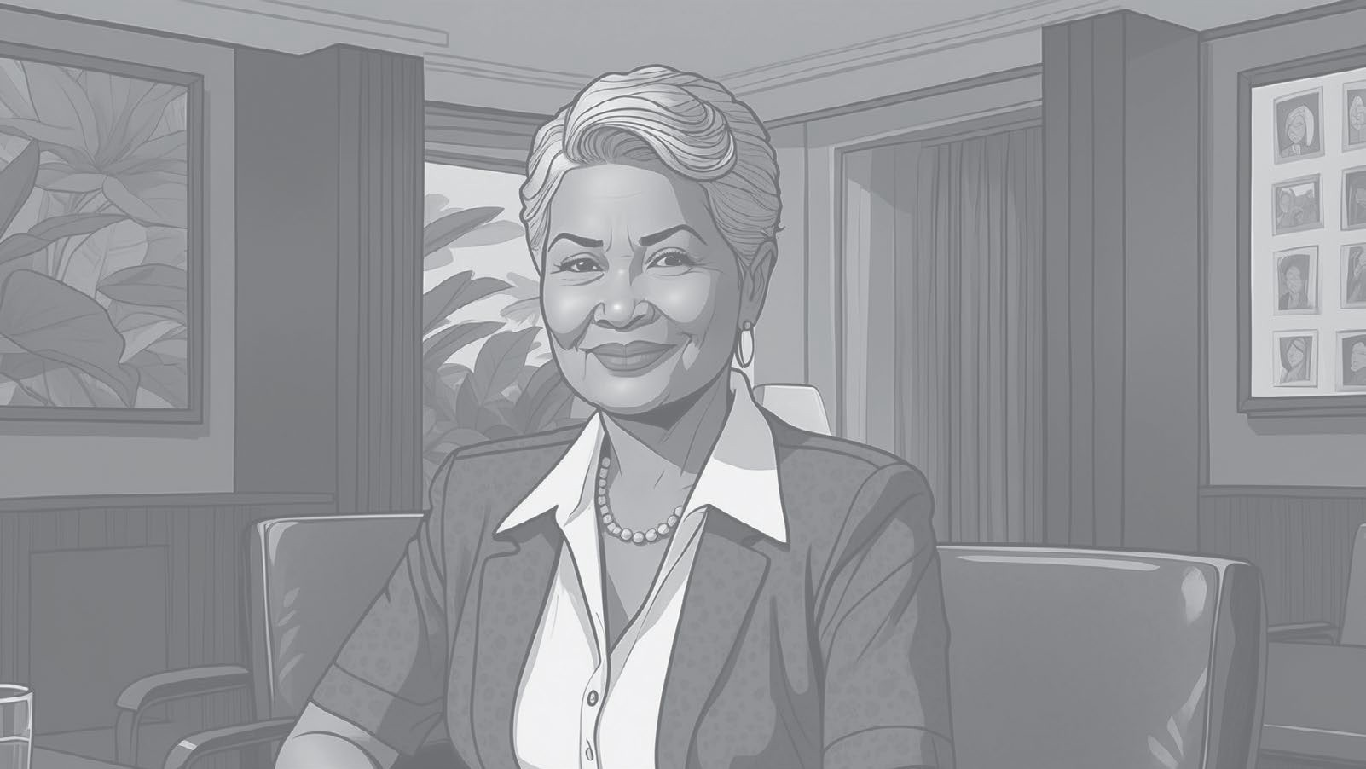
Karakia
Unuhia, unuhia
Unuhia i te uru tapu nui Kia wātea, kia māmā
te ngākau
te hinengaro te tinana
I te ara takatū
Kia wātea, kia wātea Āe, kua wātea
Release
Let go of all burdens To free and relieve The heart
Mind And body
To progress
To be free and clear Yes, we are clear
TE REO MŌ TE HUI

Slide 22

He Kupu
Raiti
Light
Matapihi
Window
Mata
Screen
Nohonga
Chair
Rorohiko
Computer
Kiore
Mouse
Pene
Pen
Pūreretā
Printer
Tēpu
Desk
Papa pātuhi
Keyboard
TE REO MŌ TE HUI

