Slide 1

TE REO MŌ TE HUI

Slide 2
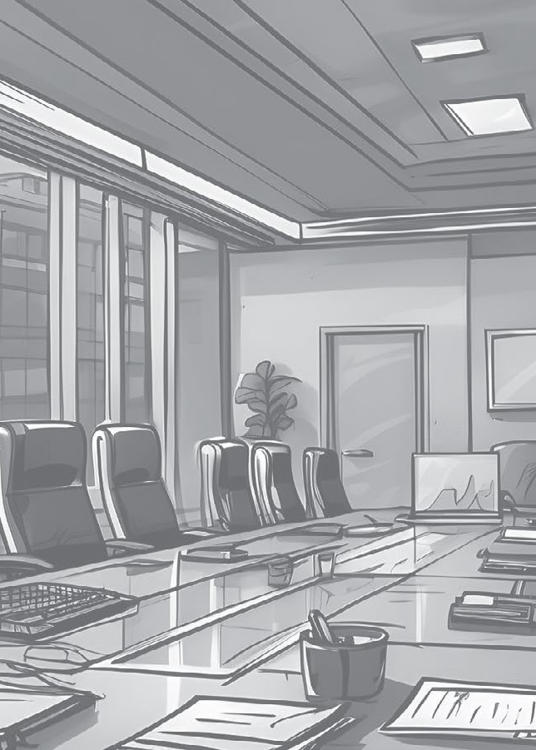
Te Ihirangi
Contents
Karakia | 3 | He Whakamānawa | 13
He Arataki Guidance | 4 | Compliments He Tūtohu | 15
He Mihi Greetings | 6 | Recommendation He Tūmahi | 16
He Rārangi Take The Agenda | 7 | Actions He Whakarāpopoto | 17
Hauora Wellbeing | 8 | Summary He Whakakapi | 18
Ngā Kōrero Hou Updates | 9 | Closing He Whakatā | 19
He Whakamārama Clarification | 10 | Relaxing He Waiata | 20
He Whakaae | 11 | Karakia | 21
Agreeing He Akiaki | 12 | He Kupu | 22
Encouragement
Kitea ai tēnei puka me ngā oro taunaki ki konei
This book and supporting audio can be found here

Slide 3
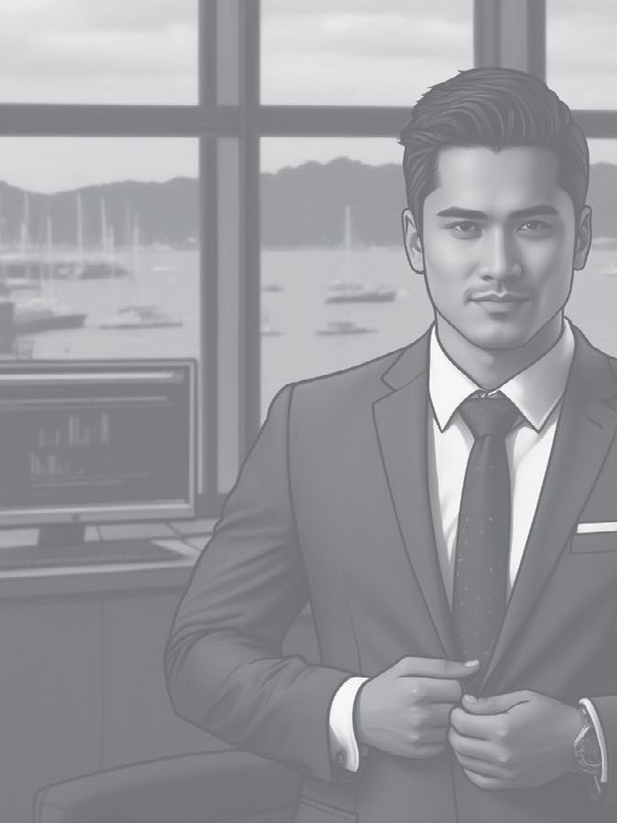

Karakia
Ko tā te karakia he tō i te aro ki te mahi o te wā, arā, he hui, he hāereere, he tīmata i te rā, he kai rānei.
Karakia are a means to bring focus and set the intention for the activity to be undertaken whether that is a meeting, travel, starting the day, or dining.
Mā te karakia e nohopuku ai tātou, e tohu ai hoki whaitake tā tātou whakakotahi.
Karakia allow us to take a moment and signal that we are gathering with purpose.
Whakamahia ai ki te tō i a koe anō, ā-tinana, ā-hinengaro, ā-kare ā-roto anō hoki.
They are used to engage yourself and others not just physically but mentally and emotionally.
Kia tau iho rā te mauri
ki tēnei wāhi
ki tēnei hui
Kia kotahi te ngākau
Kia kotahi te hinengaro Kia kotahi tātou i a tātou
Hui e!
Tāiki e!
Let’s be present
In this place,
in this meeting
One heart
One mind
United Together!
Make it so!

Slide 4
He Arataki
Guidance
I ia rā hui ai tātou ki ngā whānau, ki ngā hoa, ki ngā hoa mahi, ā, ki ngā tāngata hou.
Every day, we meet with whānau, friends, colleagues or strangers.
Ko ngā hui katoa he ara e taea ai te whakauru, te whakamahi, me te whakamāori i te reo Māori.
Every meeting is an opportunity to introduce, practice, and normalise te reo Māori.
Kei tēnei puka ētahi kīanga e whakamahia nuitia ana i ngā hui.
This booklet provides phrases that are commonly used during meetings.
Whakawhitia ngā kīanga Pākehā ki te kīanga reo Māori i te hui o muri. Kia rite tonu tō pērā kia waia haere ai – arā, kia tau noa ai. Kātahi ka koke ki kīanga kē atu.
Replace one or two English phrases with a te reo phrase during your next meeting. Stick to it, and it will become second nature – normalised. Then move on to another couple of phrases.

Slide 5
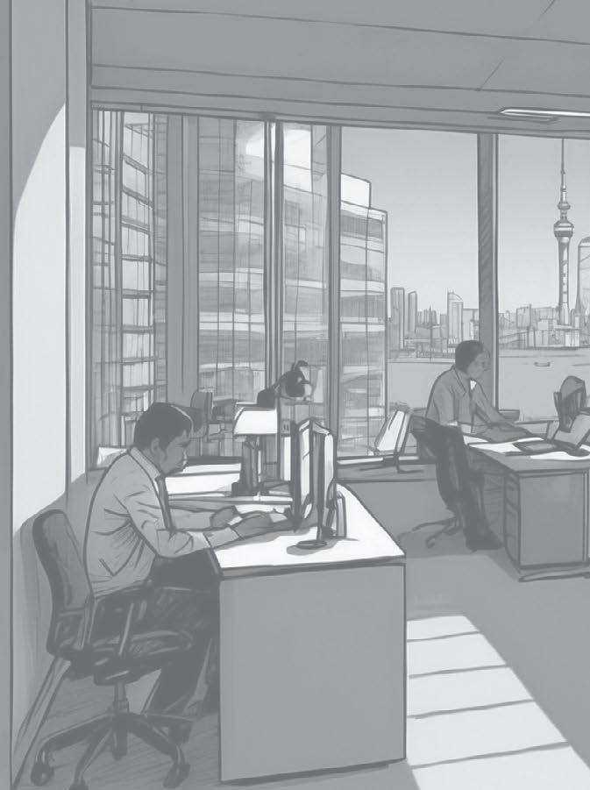



He Arataki
Guidance
Māku ngā kīanga mā te hunga tauhou.
I’ll provide phrases for beginners.
Māku ngā kīanga mā te hunga waenga.
I’ll provide phrases for intermediate learners.
Māku ngā kīanga mā te hunga tautōhito.
TE REO MŌ TE HUI
I’ll provide phrases for advanced learners.

Slide 6
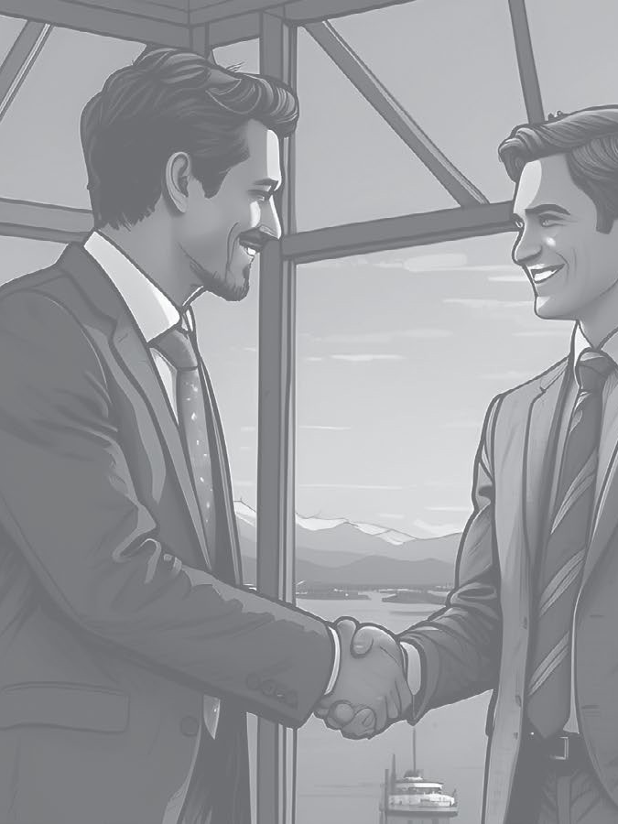
Mā te mihimihi e rangona ai ngā reo katoa o te hunga ka tae atu – kia kore ai tētahi e mahue.
Introductions allow us to hear the voices of all those who are present – ensuring no single contribution is left out.
Ākona he mihi poto i te ipurangi.
Learn a short mihi online.
He Mihi
Greetings
Tēnā koutou katoa
Welcome all
He manuhiri/tangata tauhou kei waenga
i a tātou
We have guests/ new people
TE REO MŌ TE HUI
Tēnā, whakamōhio mai ko wai tātou, he aha ā tātou mahi
Let’s share who we are and what we do

Slide 7
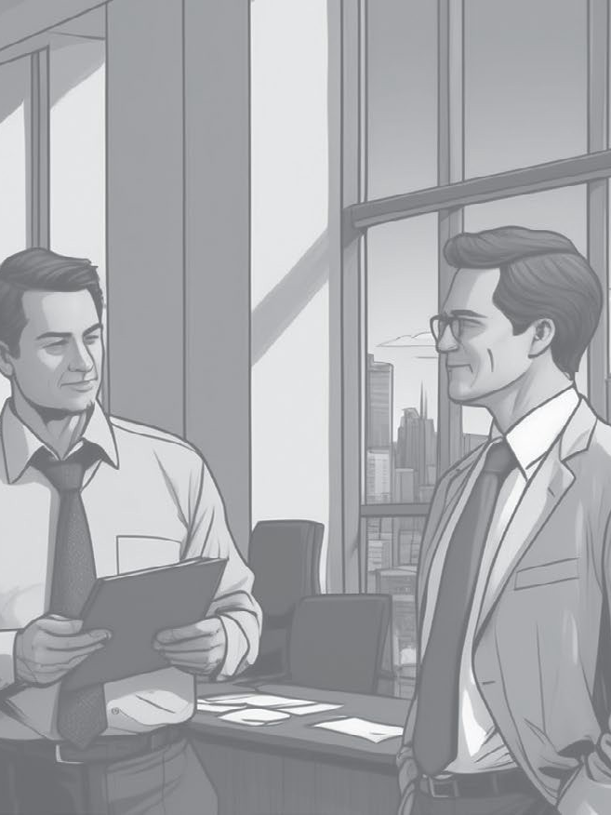
He Rārangi Take
The Agenda
Ko te kaupapa tuatahi, ko...
The first item is….
He kaupapa anō?
Anything else?
7
Kia arotake tātou i te rārangi take
TE REO MŌ TE HUI
Let’s review the agenda

Slide 8



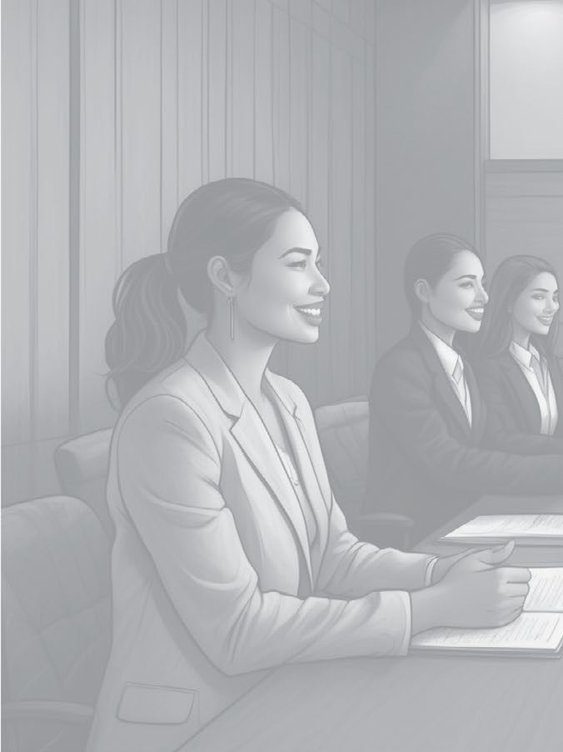





Hauora
Wellbeing
Takeo
Frustrated
Pōuri
Down
Hīkaka
Eager
Hiamo
Excited
Kei te pēhea koe?
Pōkaikaha
Stressed
How are you feeling?
I ahatia i tēnei mutunga wiki?
Ngenge
Tired
What happened this weekend?
Ohorere
Surprised
Ka taea e au te āwhina?
Can I help?
Rangirua
Confused

Slide 9
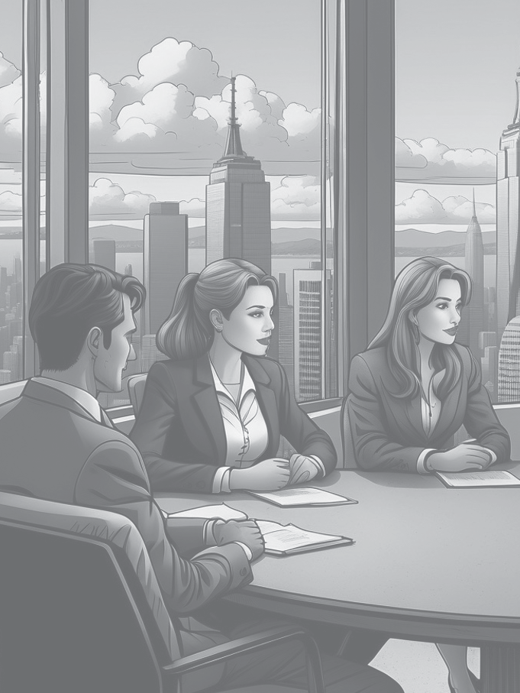
Ngā Kōrero Hou
Updates
He aha ngā kōrero hou a te Tira Whakahaere/ ngā Minita?
What’s the latest from SLT/Ministers?
E haere pai ana ngā mahi
Work’s tracking well
He aha ka whai ake?
Next steps?

Slide 10
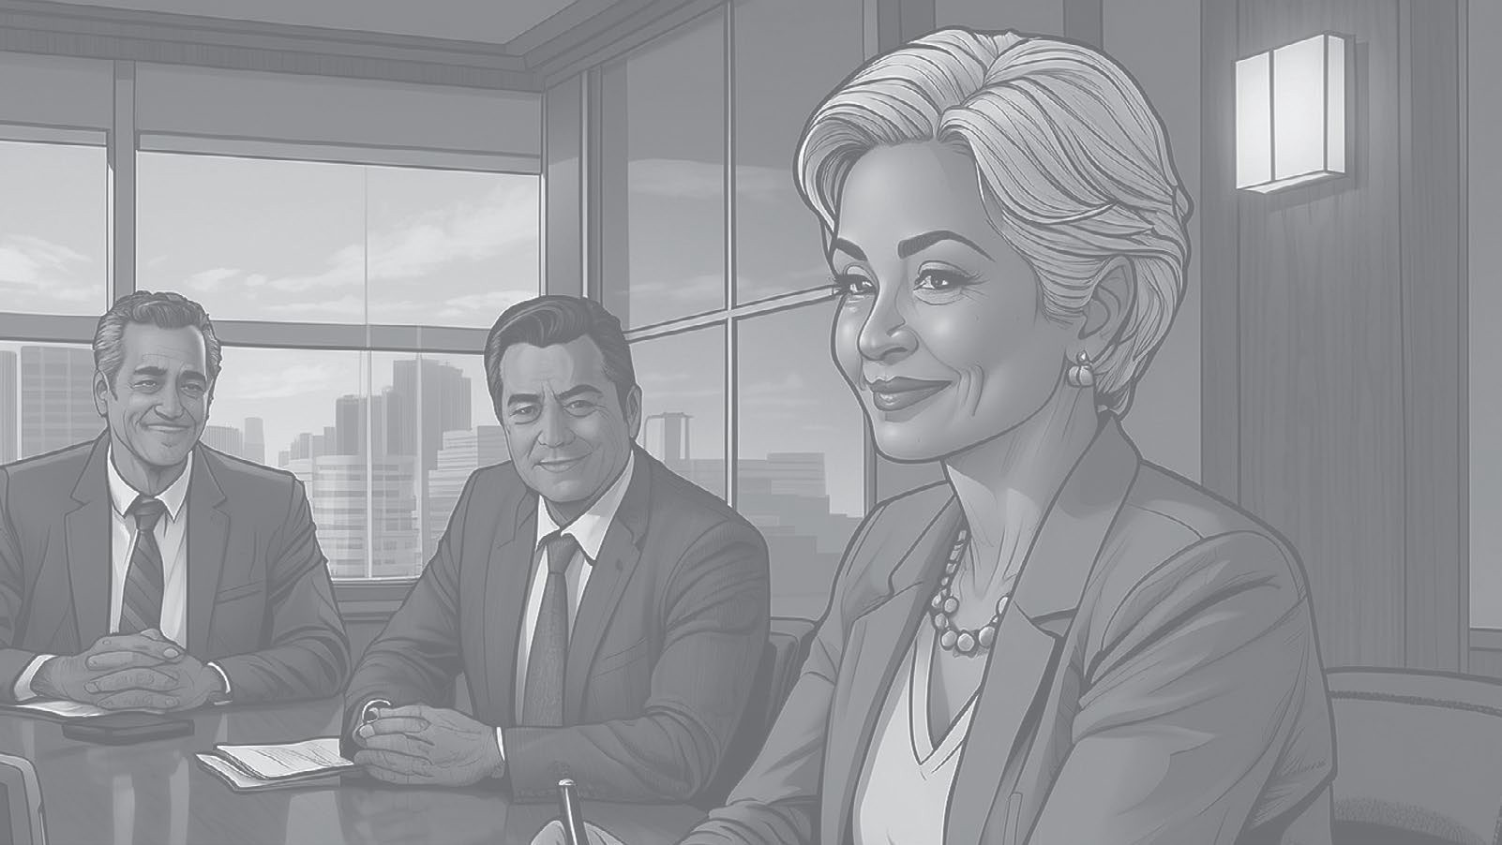
He Whakamārama
Clarification
Nōku te hē
My bad
Kāore ahau i rongo i a koe
I didn’t hear you
Tēnā, tōaitia mai
Can you go over it again?

Slide 11
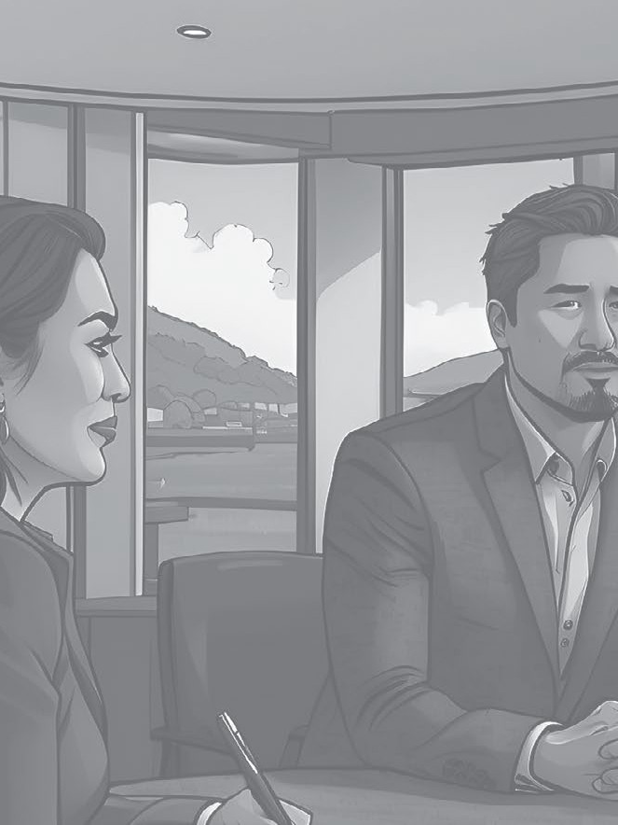
He Whakaae
Agreeing
Kei konā au
I agree
Kāore au i te whakaae
I disagree
Kimihia he whakatau
Let’s find a compromise

Slide 12
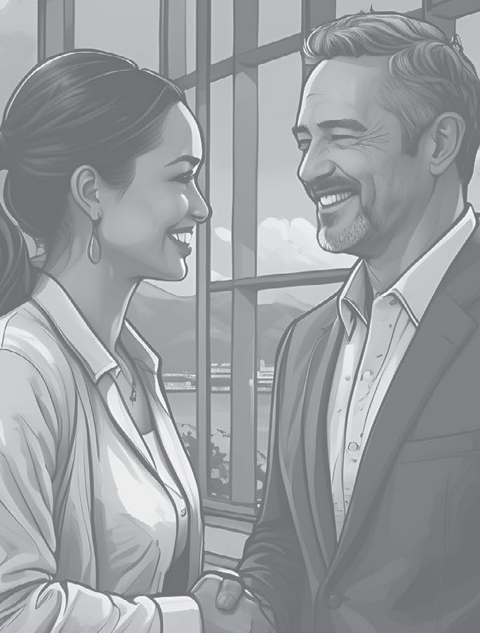
He Akiaki
Encouragement
He rōpū/hui uaua tērā
I agree
Kātahi te rā/wiki/marama/tau roa ko tērā
That was a long day/week/month/year
Kātahi te rā/ wiki/marama/tau kūnakunaku ko tērā
That was a chaotic day/ week/month/year

Slide 13
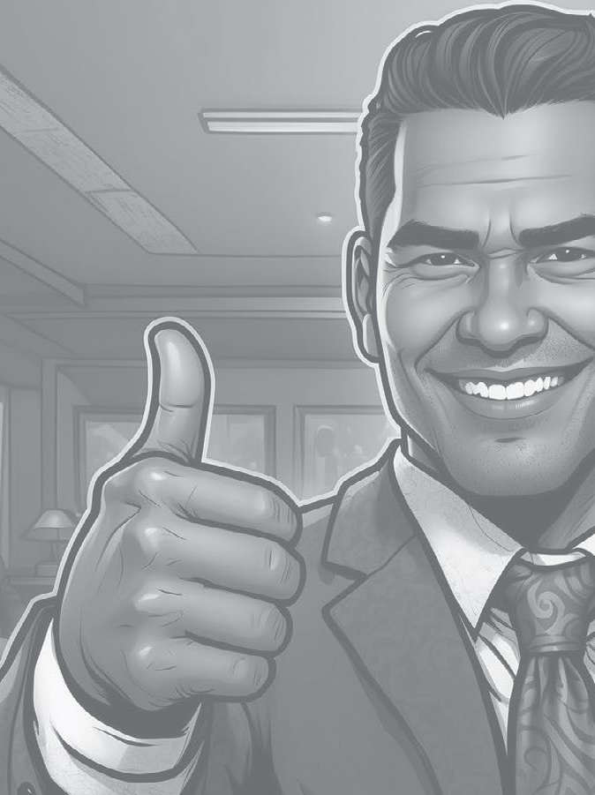
Ko koe tētahi tangata tino tautoko!
You’re so supportive!
He Whakamānawa Compliments
Tō atawhai hoki!
You’re so generous!
Kei whea mai koe!
You’re the best!
Kātahi te wairua mākoha!
So kind!
Mei kore koe...
I couldn’t have done it without you
Tēnā rā koe i ō mahi!
Thanks for everything you do!
Me nui ake taku kōrero pēnei
I should say this more often
Whakamīharo ana
TE REO MŌ TE HUI
Wow. Just wow.
Kāore e rawea e te kōiraira!
No flies on you!

Slide 14
Atamai
Resourcefulness
Ngākau reka
Positive attitude
Manawanui
Dedication
He Whakamānawa Compliments
Ngākau whiwhita
Passion
Ringa ngaio
Professionalism
Auahatanga
Creativity
Pukumahi
Hard work
Mātanga
Expertise
Arotahi
Focus
Mānawanawa
Patience
Mauritau
Composure
Pūkenga whakaoti rapanga
Problem-solving skills
Te pai mutunga o tō...
I’m impressed by your
Haramai tō…
TE REO MŌ TE HUI
I appreciate your...
E wana ake ana i tō...
I am inspired by your…

Slide 15
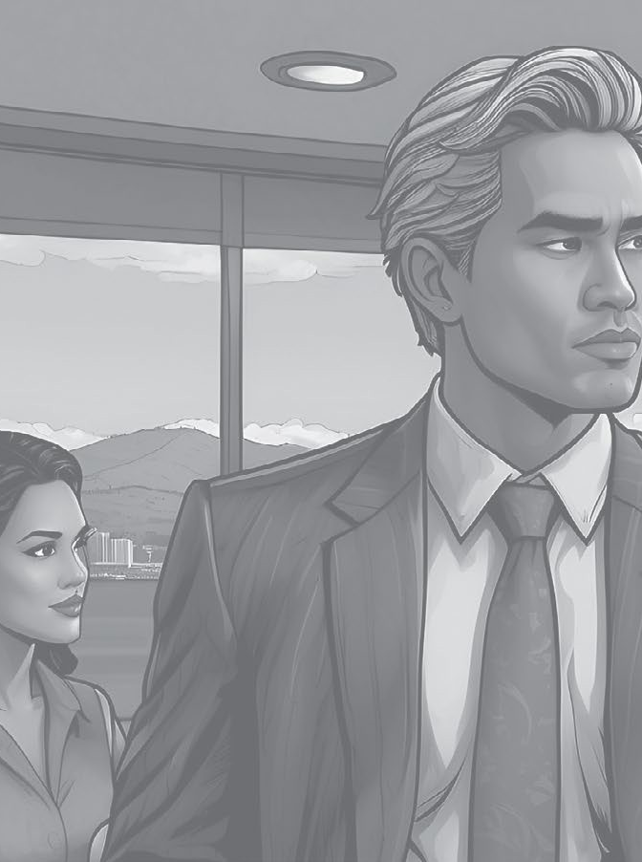
He Tūtohu
Recommendations
He whakaaro tōku
I have an idea
Ka pai pea kia
It might be good if…
Kia whakaarohia e tāua/tātou
Let’s think about

Slide 16
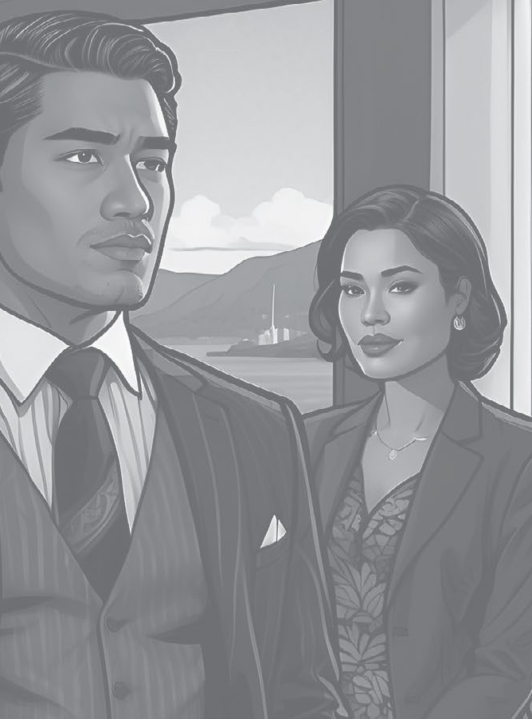
He Tūmahi
Actions
Ka taea e wai te hiki?
Who has capacity?
Ka tutuki pai tēnei i te Paraire?
Can this be done by Friday?
Martha ka kaha koe ki te āwhina i a Jim?
Martha can you help Jim?

Slide 17
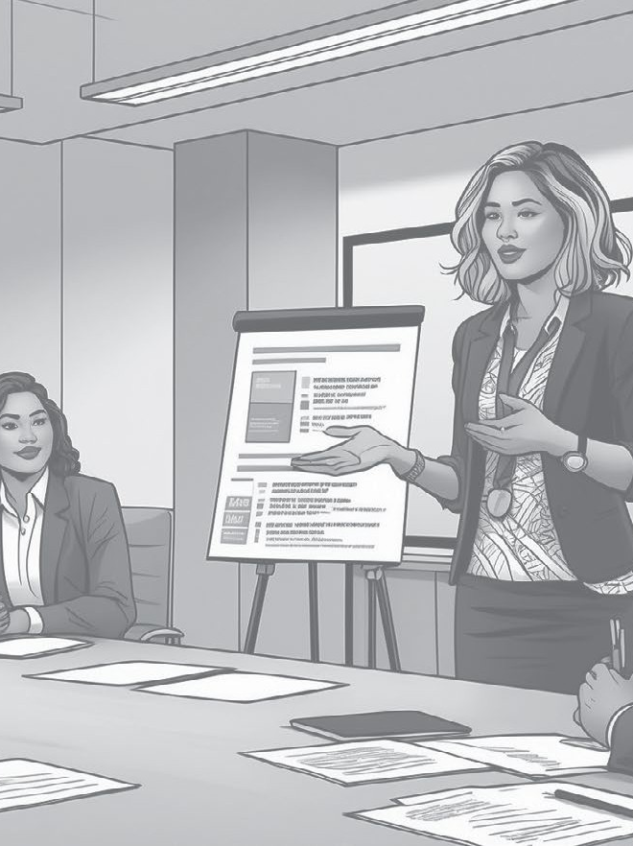
He Whakarāpopoto
Summary
Hei whakakapi ake…
To wrap up..
Kua mahue tētahi kaupapa?
Have we missed anything?
Kua matapakihia…
We’ve discussed…

Slide 18
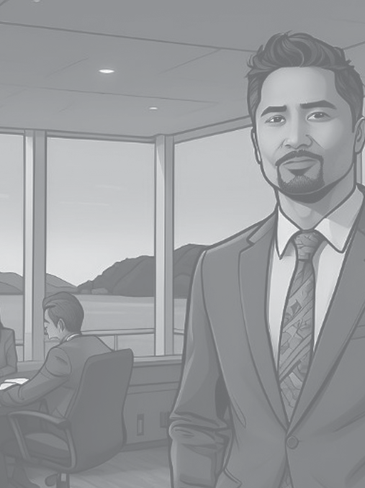
He Whakakapi
Closing
Tēnā koutou i whai wāhi mai
Thank you all for your contribution
Ka hui anō tātou ā te...
Our next meeting will be on…
Ki te kore he whakaaro atu anō, kua kapi te hui
If there are no further thoughts, this concludes the meeting

Slide 19
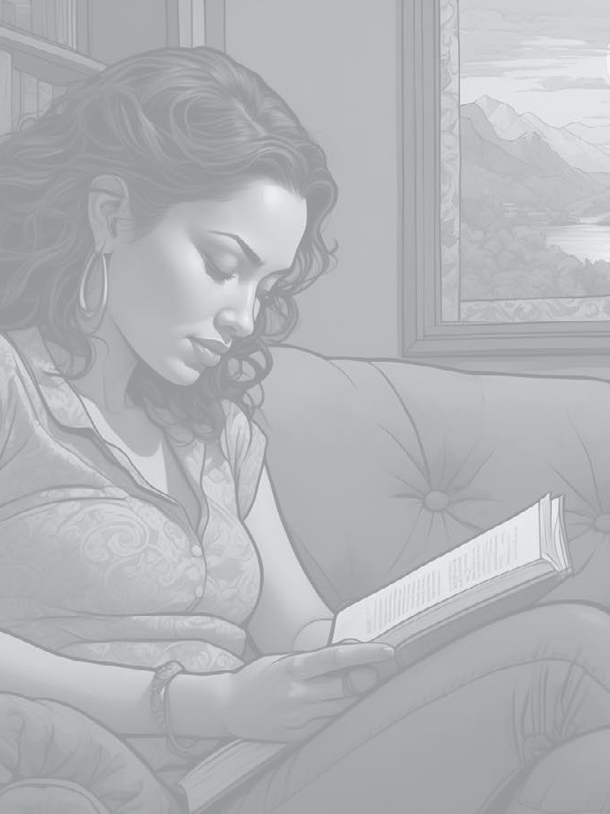
He Whakatā
Relaxing
I pēhea te rā ki a koe?
How was your day?
He aha tāu e hiahia nā?
What do you need?
E hiahia ana koe ki te kōrero ki te noho puku rānei?
Would you like to talk, or would you prefer some quiet time?

Slide 20
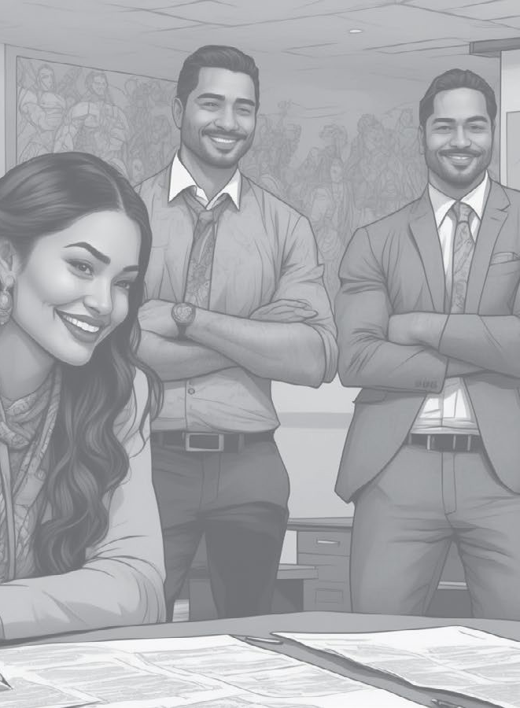
He Waiata
Poipoia te reo
Nā Te Tumatakuru O’Connell me Te Ama-Rere-Tai Rangihuna
Poipoia te reo he kura Poipoia te reo he kura Poipoia te tangata
Kia mau ko te reo Māori Ko te reo Māori
Hei taonga tuku iho mō ngā uri whakatupu e
Poipoia te reo he kura Poipoia te reo he kura Poipoia te tangata
Kia mau ko te reo Māori Ko te reo Māori
Hei taonga tuku iho mō Aotearoa e
Poipoia te reo
Composed by Te Tumatakuru O’Connell and Te Ama-Rere-Tai Rangihuna
Look after the language it’s precious
Look after the language it’s valuable Encourage people
To take up the Māori language
The Māori language
To be a precious heirloom for future generations
Look after the language it’s precious
Look after the language it’s valuable Encourage people
To take up the Māori language
The Māori language
To be a precious heirloom for New Zealand

Slide 21
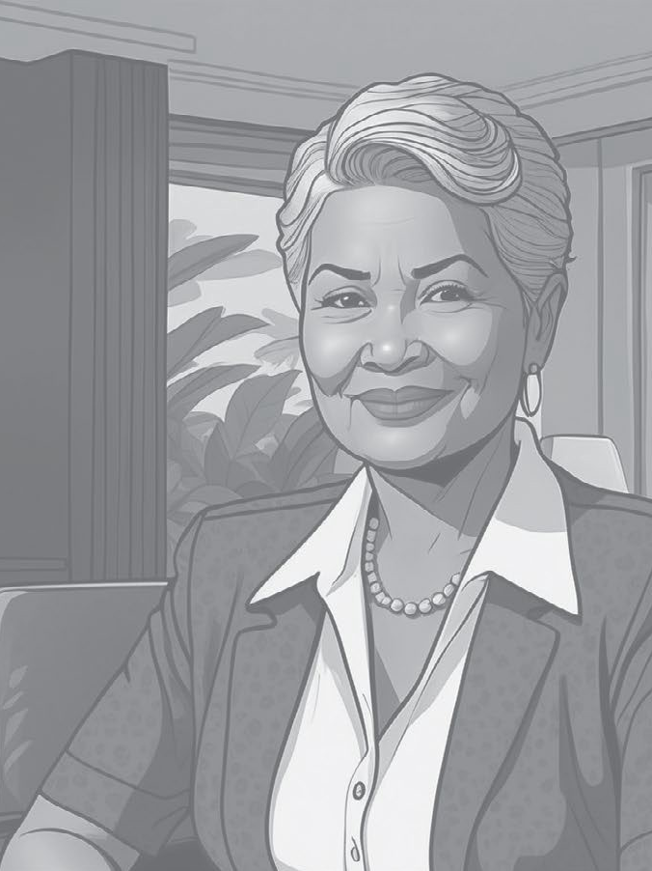
Karakia
Unuhia, unuhia
Unuhia i te uru tapu nui
Kia wātea, kia māmā
te ngākau
te hinengaro
te tinana
I te ara takatū
Kia wātea, kia wātea
Āe, kua wātea
Release
Let go of all burdens
To free and relieve
The heart
Mind
And body
To progress
To be free and clear
Yes, we are clear

Slide 22

He Kupu
Raiti
Light
Matapihi
Window
Mata
Screen
TE REO MŌ TE HUI
Rorohiko
Computer
Pene
Pen
Kiore
Mouse
Tēpu
Desk
Papa pātuhi
Keyboard
Nohonga
Chair

